Slide 1
Wedged Chord
From a puzzle by Catriona Shearer

Slide 2

Wedged Chord
$$6$$
The figure shows a rectangle, a semicircle and a chord, aligned as shown.
What’s the shaded area?

Slide 3

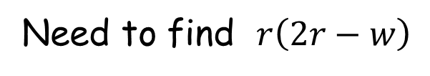



Wedged Chord
Need to find $r\left(2r−w\right)$
$$r$$
$$6$$
$$h$$
$$w$$
$$2r−w$$

Slide 4

Wedged Chord
Need to find $r\left(2r−w\right)$
$$h^{2}+{\left(2r−w\right)}^{2}=6^{2}$$
(Pythagoras’ theorem)
$$r$$
$$6$$
$$h$$
$$w$$
$$2r−w$$

Slide 5
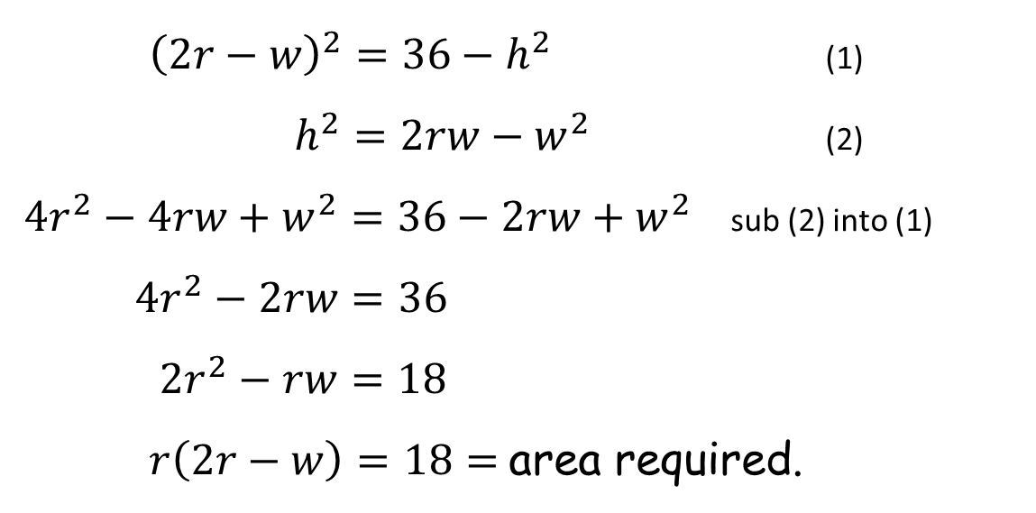


Wedged Chord
Need to find $r\left(2r−w\right)$
$$h^{2}+{\left(2r−w\right)}^{2}=6^{2}$$
(Pythagoras’ theorem)
$$r$$
$$6$$
$$h×h=w×\left(2r−w\right)$$
(Intersecting Chords
theorem)
$$h$$
${\left(2r−w\right)}^{2}=36−h^{2}$ (1)
$h^{2}=2rw−w^{2}$ (2)
${4r}^{2}−4rw+w^{2}=36−2rw+w^{2}$ sub (2) into (1)
${4r}^{2}−2rw=36$
$2r^{2}−rw=18$
$r\left(2r−w\right)=18=$ area required.
$$w$$
$$2r−w$$
$$h$$

Slide 6
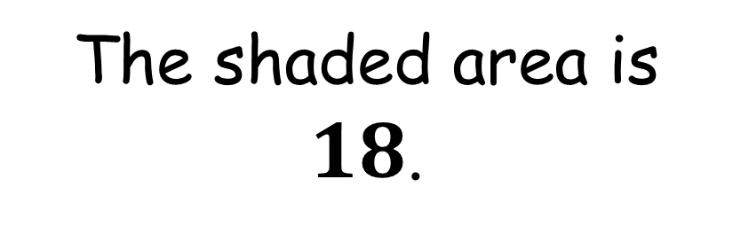
Wedged Chord
$$6$$
The shaded area is $18$.

Slide 7


Wedged Chord
There is another way …
Given that only one dimension was given we could conjecture that we could alter where the chord is.
$$6$$
$$6$$
$$6$$

Slide 8






Wedged Chord
There is another way …
$$\frac{6}{\sqrt{2}}$$
$$6$$
$$3$$
$$6$$
$$\frac{6}{\sqrt{2}}$$
Again, the shaded area is $18$.

Slide 10
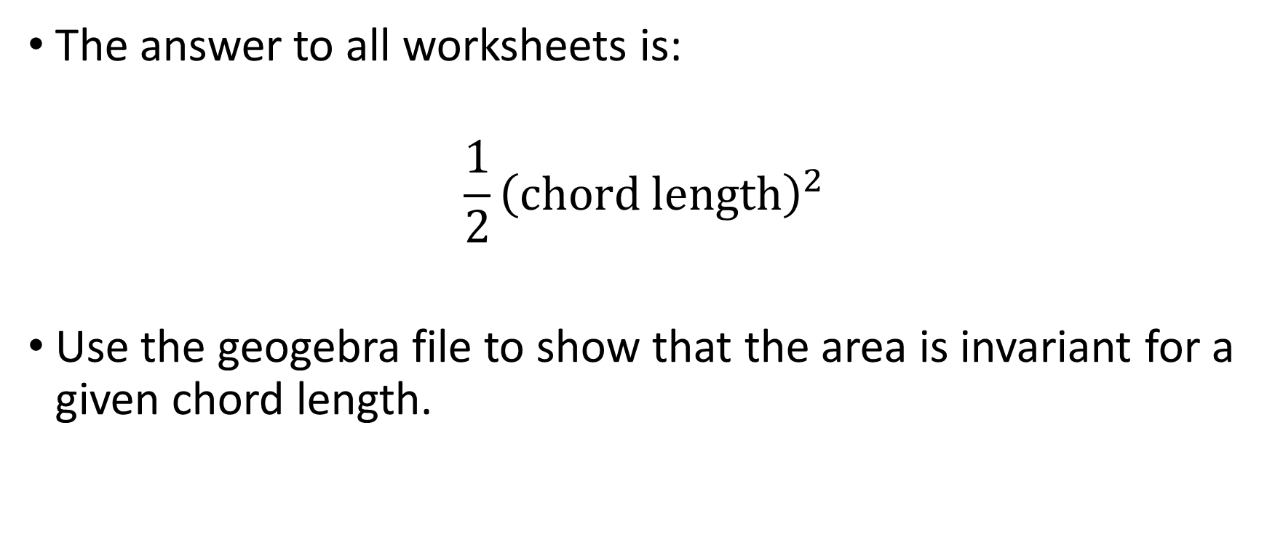
Note to Teacher
The answer to all worksheets is:
$$\frac{1}{2}{\left(chord length\right)}^{2}$$
Use the geogebra file to show that the area is invariant for a given chord length.

Slide 11
RESOURCES

Slide 12

Wedged Chord
$$2$$
The figure shows a rectangle, a semicircle and a chord, aligned as shown.
What’s the shaded area?
SIC_78

Slide 13

Wedged Chord
$$5$$
The figure shows a rectangle, a semicircle and a chord, aligned as shown.
What’s the shaded area?
SIC_78

Slide 14

Wedged Chord
$$4$$
The figure shows a rectangle, a semicircle and a chord, aligned as shown.
What’s the shaded area?
SIC_78

Slide 15

Wedged Chord
$$3$$
The figure shows a rectangle, a semicircle and a chord, aligned as shown.
What’s the shaded area?
SIC_78

Slide 16

Wedged Chord
$$7$$
The figure shows a rectangle, a semicircle and a chord, aligned as shown.
What’s the shaded area?
SIC_78

Slide 17

Wedged Chord
$$8$$
The figure shows a rectangle, a semicircle and a chord, aligned as shown.
What’s the shaded area?
SIC_78

Slide 18

Wedged Chord
$$9$$
The figure shows a rectangle, a semicircle and a chord, aligned as shown.
What’s the shaded area?
SIC_78

Slide 19

Wedged Chord
$$10$$
The figure shows a rectangle, a semicircle and a chord, aligned as shown.
What’s the shaded area?
SIC_78

Slide 20
Wedged Chord
11
The figure shows a rectangle, a semicircle and a chord, aligned as shown.
What’s the shaded area?
SIC_78

Slide 21

Wedged Chord
$$12$$
The figure shows a rectangle, a semicircle and a chord, aligned as shown.
What’s the shaded area?
SIC_78

Slide 22

Wedged Chord
$$14$$
The figure shows a rectangle, a semicircle and a chord, aligned as shown.
What’s the shaded area?
SIC_78

Slide 23

Wedged Chord
$$16$$
The figure shows a rectangle, a semicircle and a chord, aligned as shown.
What’s the shaded area?
SIC_78

Slide 24
Wedged Chord
$$6$$
The figure shows a rectangle, a semicircle and a chord, aligned as shown.
What’s the shaded area?
SIC_78

Slide 25
Wedged Chord
$$5$$
The figure shows a rectangle, a semicircle and a chord, aligned as shown.
What’s the shaded area?
SIC_78

Slide 26
Wedged Chord
$$4$$
The figure shows a rectangle, a semicircle and a chord, aligned as shown.
What’s the shaded area?
SIC_78

Slide 27
Wedged Chord
$$3$$
The figure shows a rectangle, a semicircle and a chord, aligned as shown.
What’s the shaded area?
SIC_78

Slide 28
Wedged Chord
$$7$$
The figure shows a rectangle, a semicircle and a chord, aligned as shown.
What’s the shaded area?
SIC_78

Slide 29
Wedged Chord
$$8$$
The figure shows a rectangle, a semicircle and a chord, aligned as shown.
What’s the shaded area?
SIC_78

Slide 30
Wedged Chord
$$9$$
The figure shows a rectangle, a semicircle and a chord, aligned as shown.
What’s the shaded area?
SIC_78

Slide 31
Wedged Chord
$$10$$
The figure shows a rectangle, a semicircle and a chord, aligned as shown.
What’s the shaded area?
SIC_78

Slide 32
Wedged Chord
11
The figure shows a rectangle, a semicircle and a chord, aligned as shown.
What’s the shaded area?
SIC_78

Slide 33
Wedged Chord
$$12$$
The figure shows a rectangle, a semicircle and a chord, aligned as shown.
What’s the shaded area?
SIC_78

Slide 34
Wedged Chord
$$14$$
The figure shows a rectangle, a semicircle and a chord, aligned as shown.
What’s the shaded area?
SIC_78

Slide 35
Wedged Chord
$$16$$
The figure shows a rectangle, a semicircle and a chord, aligned as shown.
What’s the shaded area?
SIC_78

